Slide 1

Anti-shake cup holder
- Special made foe Parkinson’s patients
Done by: Leen Amr & Taha khalaf

Slide 2
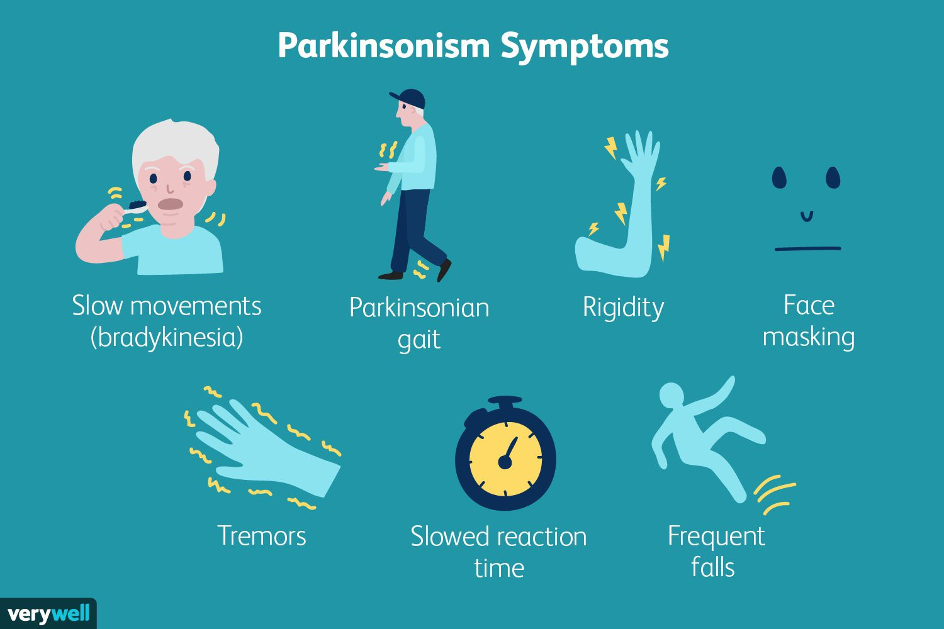
What is parkinson’s disease?
Parkinson's disease is a progressive disorder that affects the nervous system and the parts of the body controlled by the nerves. Symptoms start slowly. The first symptom may be a barely noticeable tremor in just one hand. Tremors are common, but the disorder may also cause stiffness or slowing of movement.

Slide 3

why cup holder?
One of the most common problems Parkinson’s patients face is struggling with using cups to drink due to their shaky hands that spills the drink out of the cup.

Slide 4

How can we help solve this problem?
Since we can’t control the shake of the hands, we need to think of a way to control the cup while drinking.

Slide 5
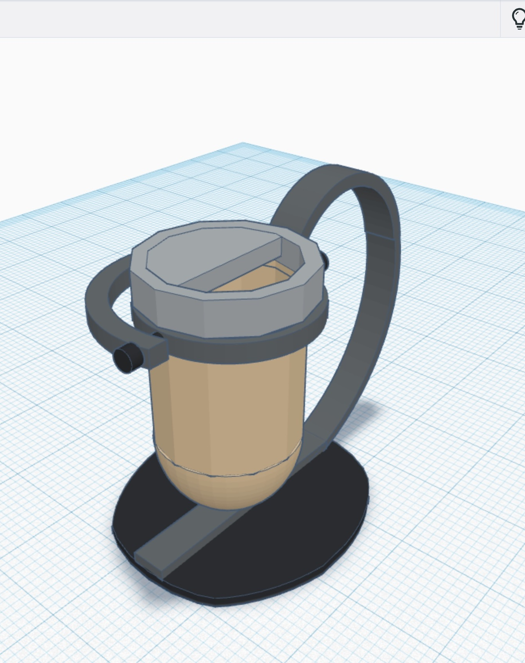
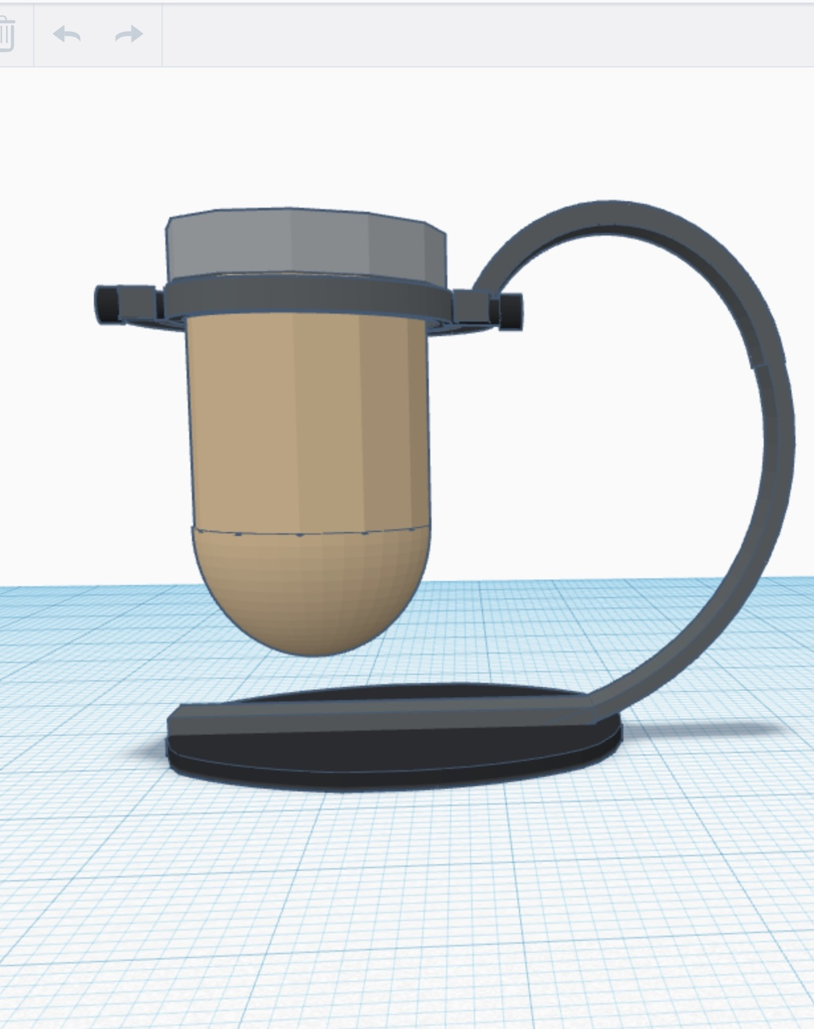
Tinkercad design

Slide 6
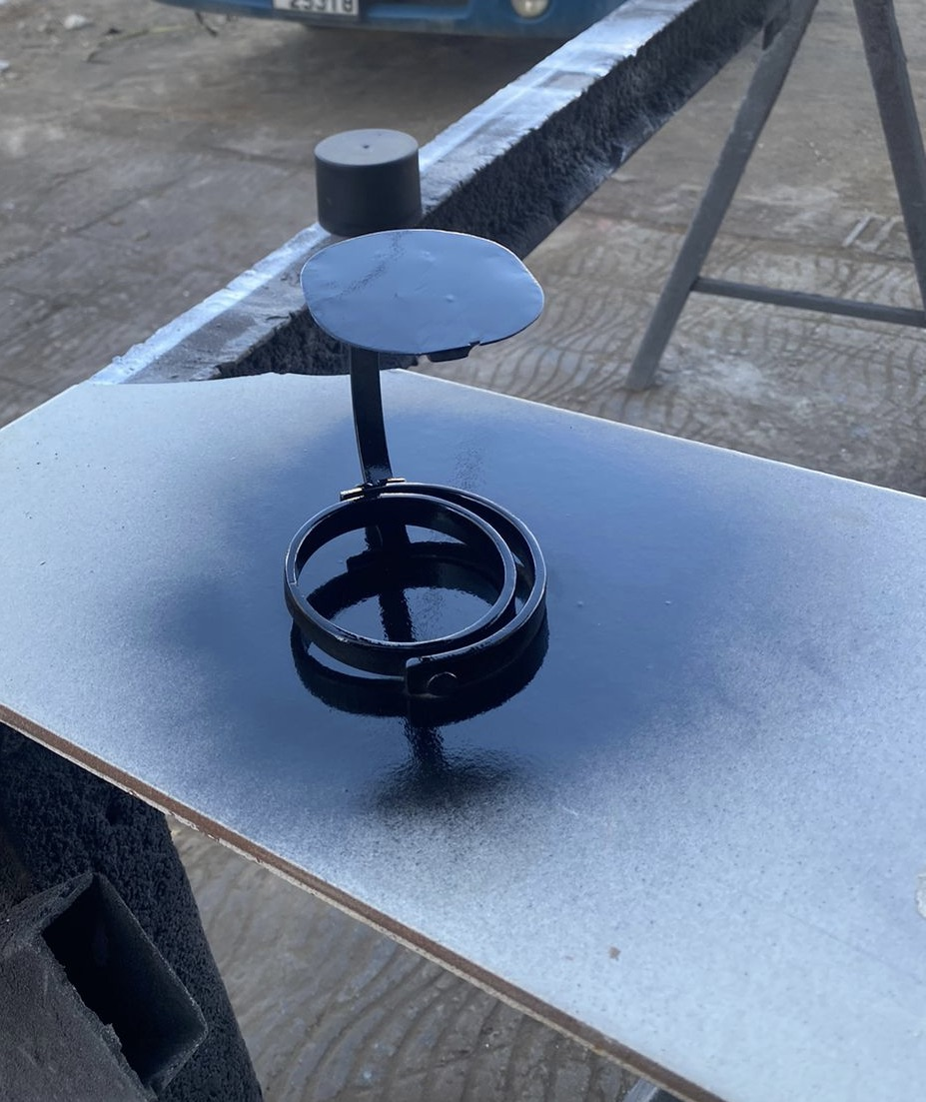
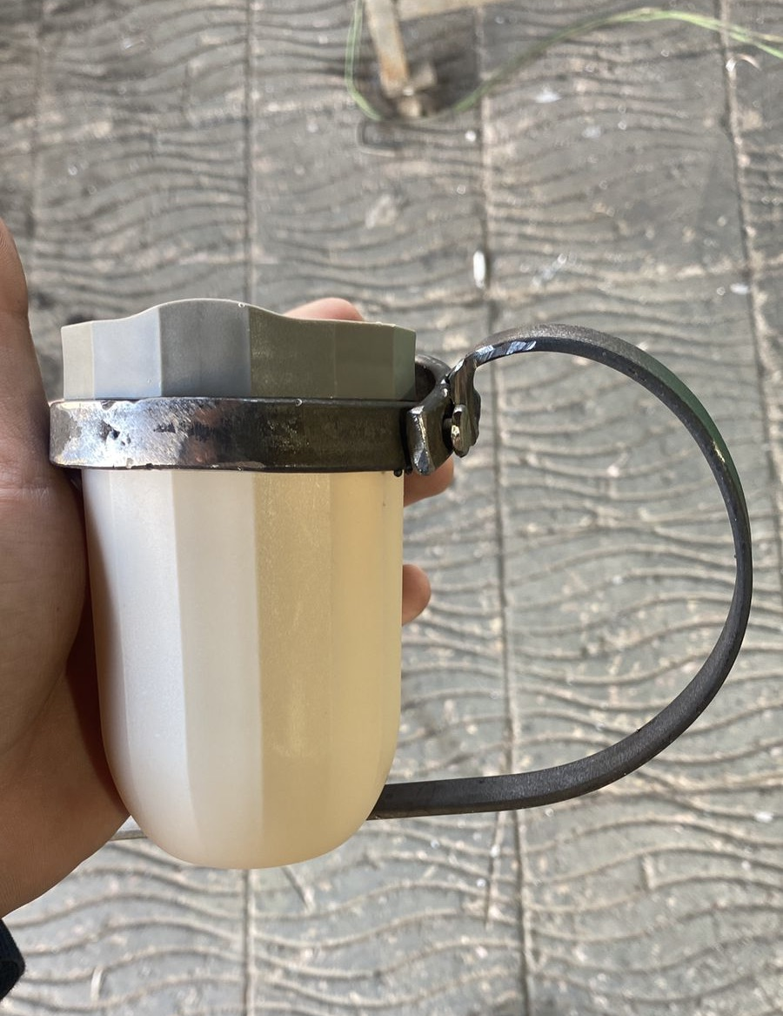
Process of work

Slide 7
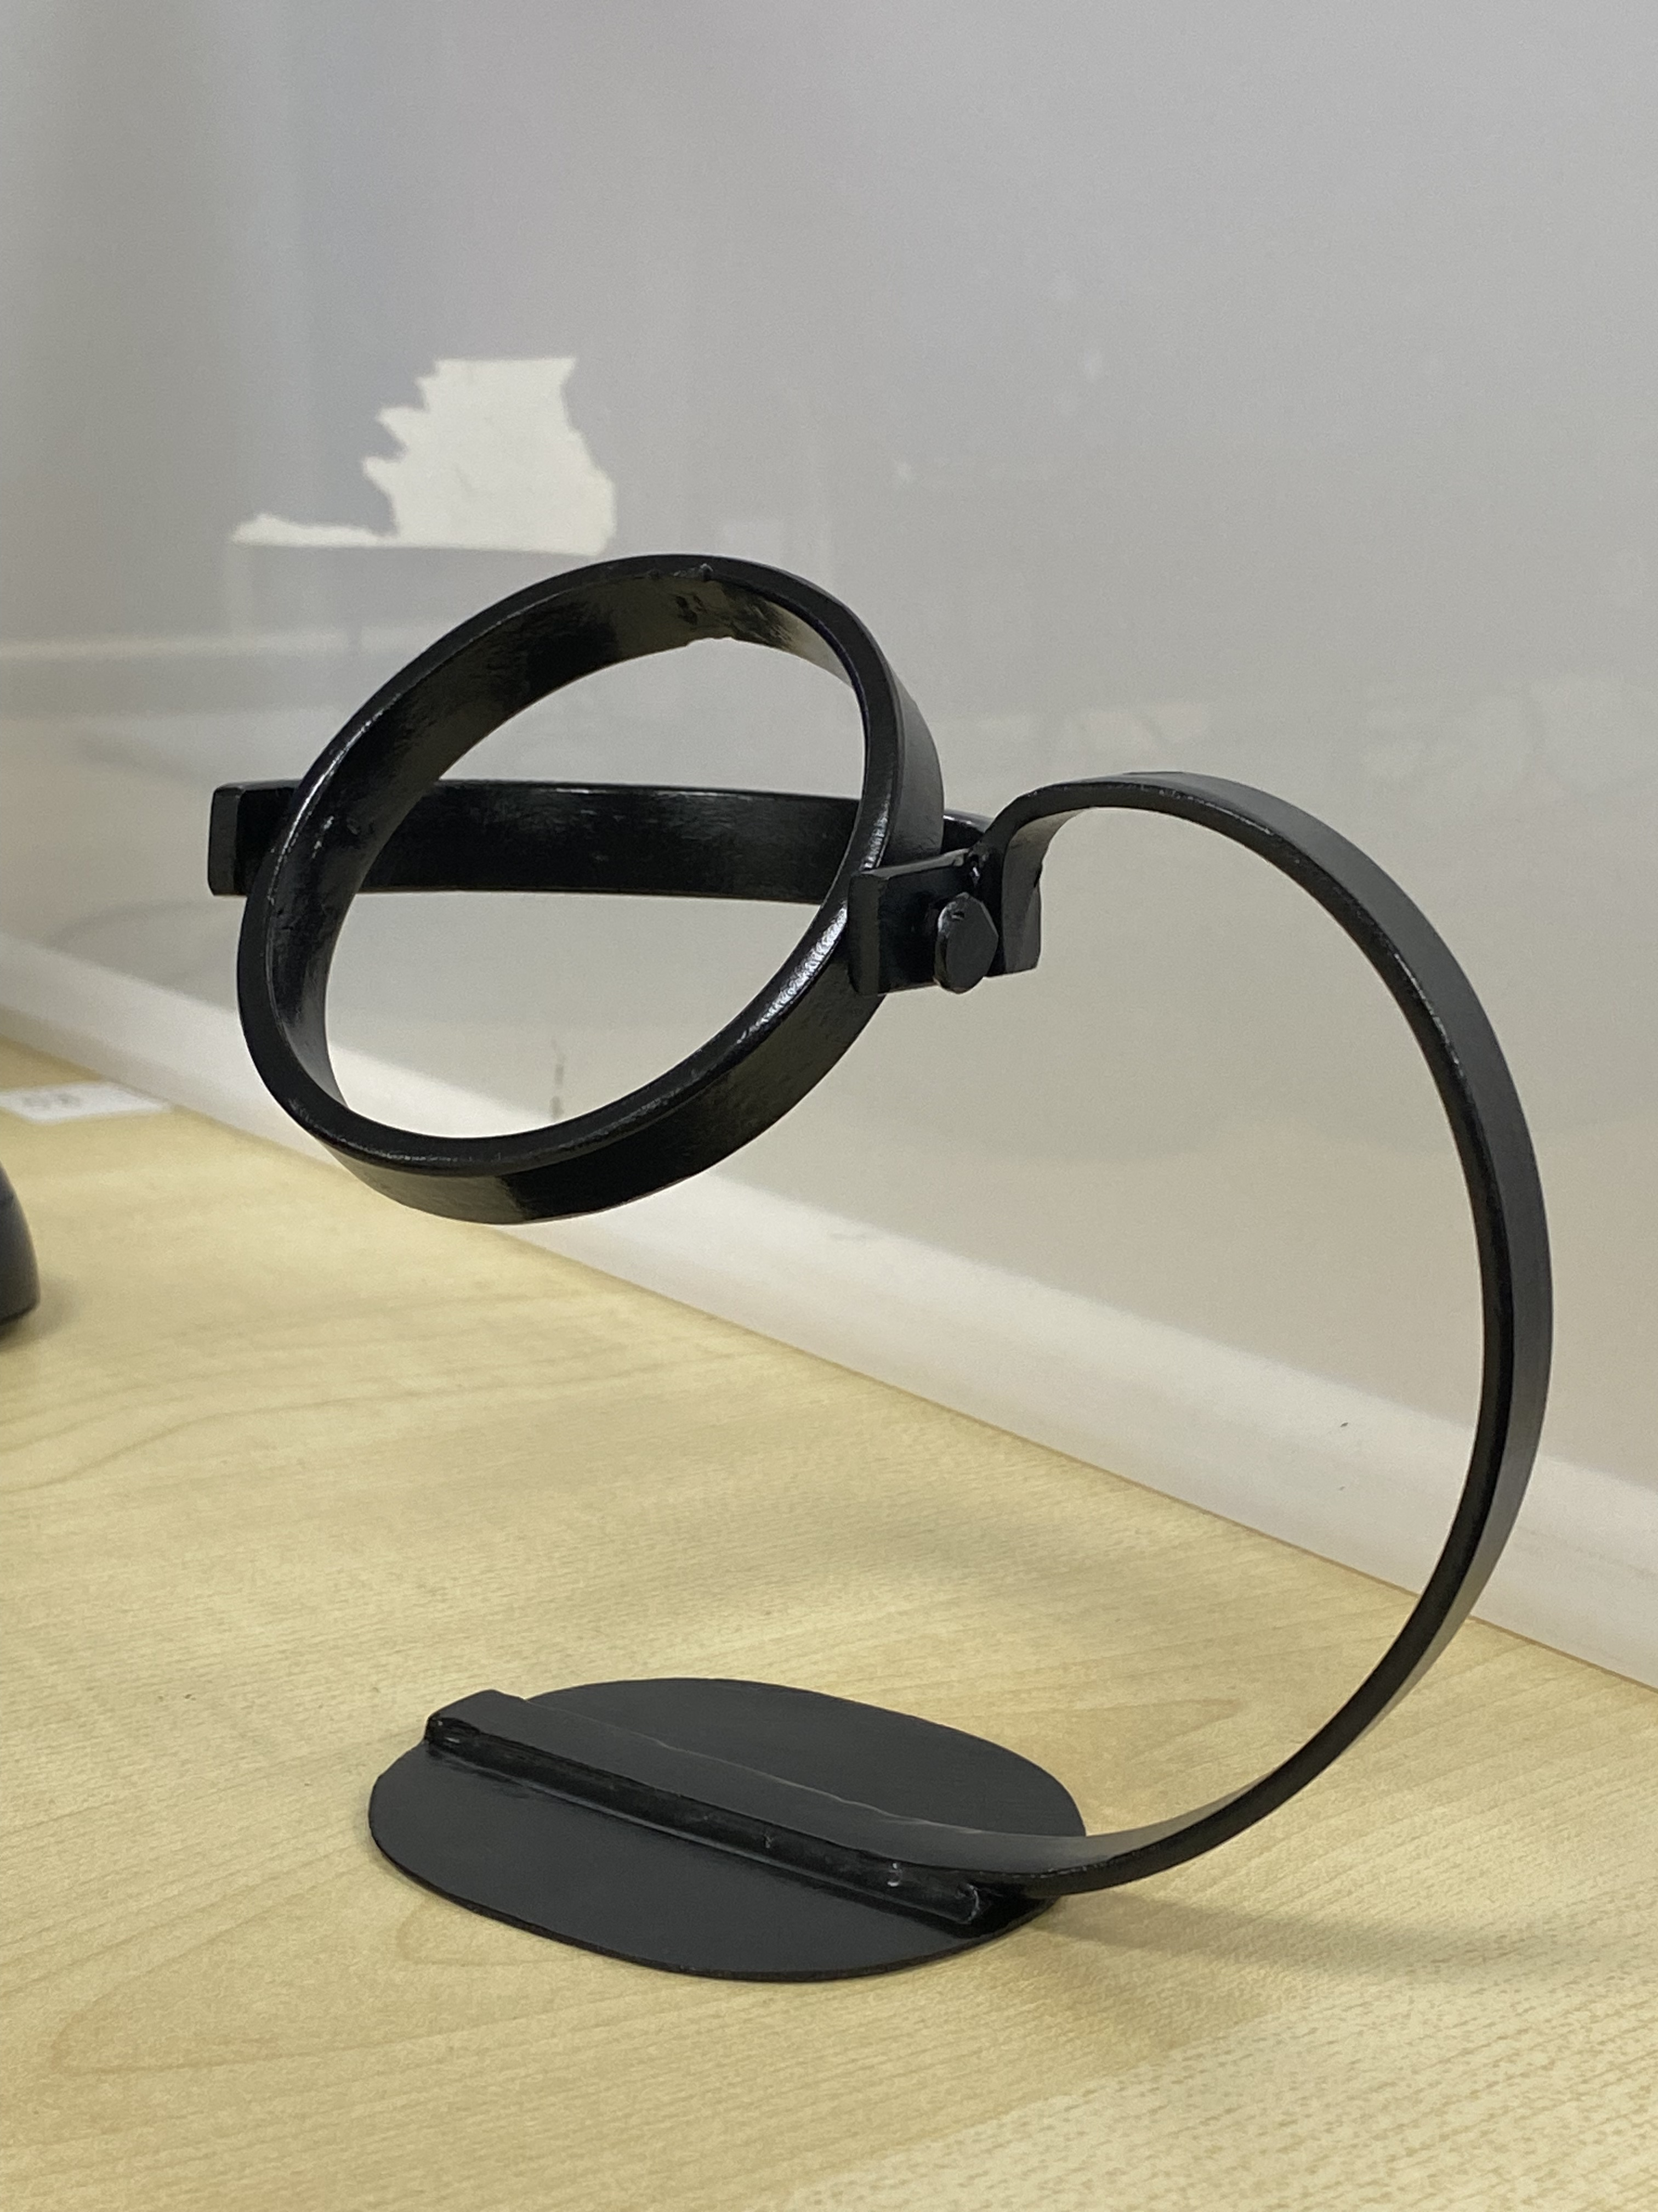
final result

Slide 8
Thank you !

